Slide 1

Team Falcons Team no:8
Team members
ABIN BINU SAM
JERIL MONZI JACOB
ASHIK DAVID ABRAHAM
SAURAV K J
VIVEK K P
This Photo by Unknown Author is licensed under CC BY-SA-NC

Slide 2

Superare
Says OVERCOME in Latin

Slide 3
problem
Disabled persons face problem to move around without the help of others
These people are dependent on others for the rest of their lives
Older people find difficulty to walk around and do their daily choirs and if they live alone …
Persons with severe disability must need the help of others even for their daily needs

Slide 4

Solution
A wheelchair is a solution to the early mentioned people and still needs the help of another person to move around
A home nurse needs to be appointed inorder to maintain the health of the person

Slide 5
“ I can’t change the direction of wind but I can adjust my sails to always reach my destination jimmy dean
”

Slide 6
Our solution!!
Ofcourse a wheelchair, but not the traditional one.
A motorized wheel chair with voice control command system enabled
Commands given through an app in the android phone
Ultrasonic sensation system for safety
Movable headrest for comfort of the user

Slide 7
Components used
Arduino Mega as CORE
HC05-Bluetooth module for COMMUNICATION
DC Motors for MOTION
Servo Motors for ADJUSTING SEATS
9V Batteries for ENERGY
L293D Modules as DRIVER
Ultrasonic Sensor as OBSTACLE DETECTOR
JUMPERWIRES,WHEELS,CARDBOARD

Slide 8
KEY FEATURES
Voice controller
Obstacle ALARMING SYSTEM
Low cost design
Easy to operate
Light weight
electronically adjustable seats.

Slide 9
Theme and our project
“ROBOTICS FOR HUMANITY”
We Team Falcons sticks on to theme by considering the weaker sections of the society,the ones that need care and bundles of self confidence.
By this project we hope that they will ‘superare’ the hurdles of life the reality.
Making differently abled persons move indepedently

Slide 10
AVERAGE COST
ARDUINO ATMEGA - 2000
DC MOTER - 3100*4
MOTER DRIVER - 2000*2
BLUTOOTH MODULE - 500
ULTARASONIC SENSOR - 99*6
STRUCTURE - 2500
SERVO MOTER - 3000
COST(approx.) -22000/-

Slide 11
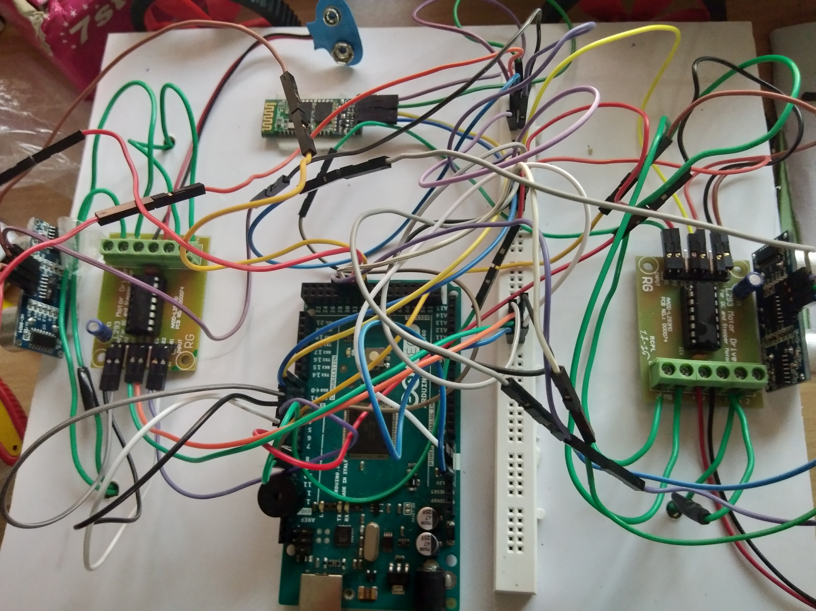
PICTURES

